Slide 1
Cascade Junior-Senior High School Wastewater Treatment System Evaluation Mill Creek Community School Corporation
Joe Tierney, P.E.
Darren Wells, P.E., BCEE
December 11, 2019 - 7:00 p.m.

Slide 2
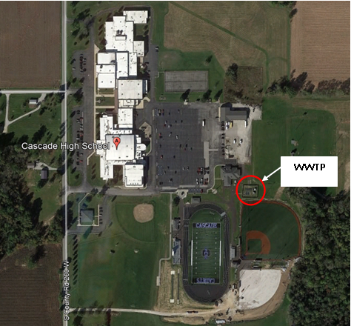
Background and Purpose
Preliminary evaluation for upgrading existing
Cascade Jr./Sr. HS wastewater treatment facilities
Scope of Work
New Bio-Mechanical “Package”
Treatment Plant
Demolish Existing WWTP
Relocate away from athletic fields
Regionalization
Demolish Existing WWTP
New Sanitary Lift Station (Pump to Clayton)

Slide 3
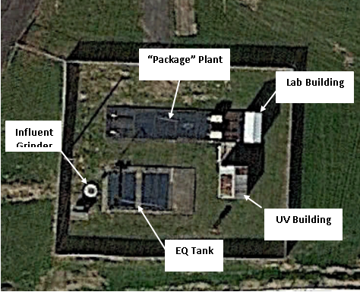
Existing Conditions Description of Existing Facilities
Dates to 1960’s and 1970’s
Rated 0.022 MGD (22,000 gpd)
“Activator” Package Plant
Current Flows
Avg. Day = 7,000 gpd
Max. Month = 14,000 gpd
Max. Day = 28,000 gpd
Peak Hour = 42,000 gpd±

Slide 4
Future Conditions 20 Year Population & Flows
Future Population Projection
Future Flow Projection
Average Day = 8,000 gpd
Max. Month = 16,000 gpd
Max. Day = 32,000 gpd
Peak Hour = 49,000 gpd
Year | Students | Employees | Total
2020 (Start) | 870 | 112 | 982
2025 | 895 | 122 | 1017
2030 | 921 | 132 | 1053
2035 | 948 | 142 | 1090
2040 (End) | 975 | 152 | 1127
% Pop. Distribution | 100% | 16% | 84%
% Growth, Total | 12% | 36% | 15%
% Growth, Annual | 0.6% | 1.8% | 0.7%

Slide 5
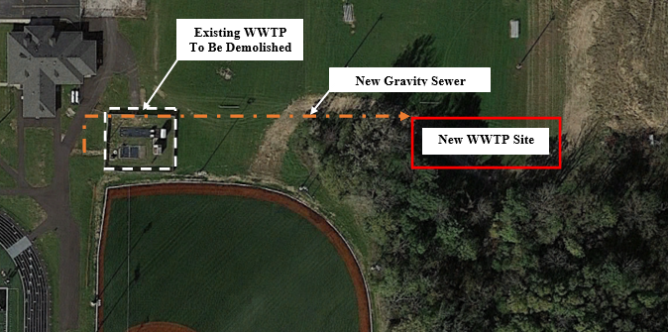
Evaluation of Alternatives Alternative 1 - WWTP Upgrades
New 25,000 gpd “Package Plant”

Slide 6
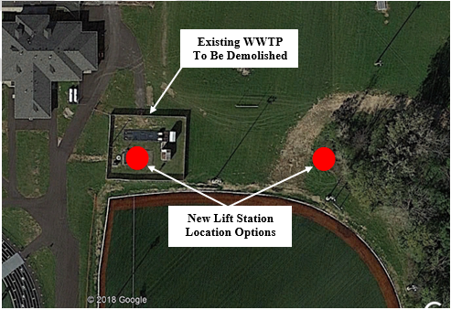
Evaluation of Alternatives Alternative 2 - Regionalization
Pumping to Town of Clayton
New Lift Station & Forcemain

Slide 7
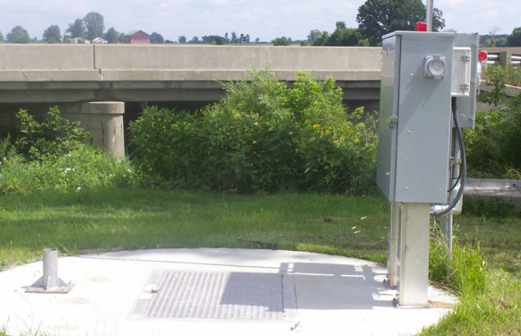
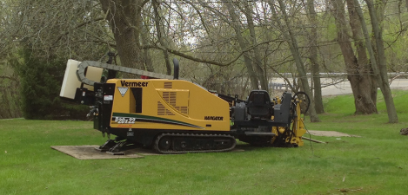
Evaluation of Alternatives Alternative 2 - Regionalization
Pumping Alternatives Considered
Alternative 2-1 via CR0
Alternative 2-1A to Clayton WWTP
Alternative 2-2 via CR500
Pumping Rate = 200 to 250 gpm
Distance = 17,500 to 20,000 LF
Forcemain Size
6” PVC Pipe
8” HDPE Pipe
Installation Method

Slide 8
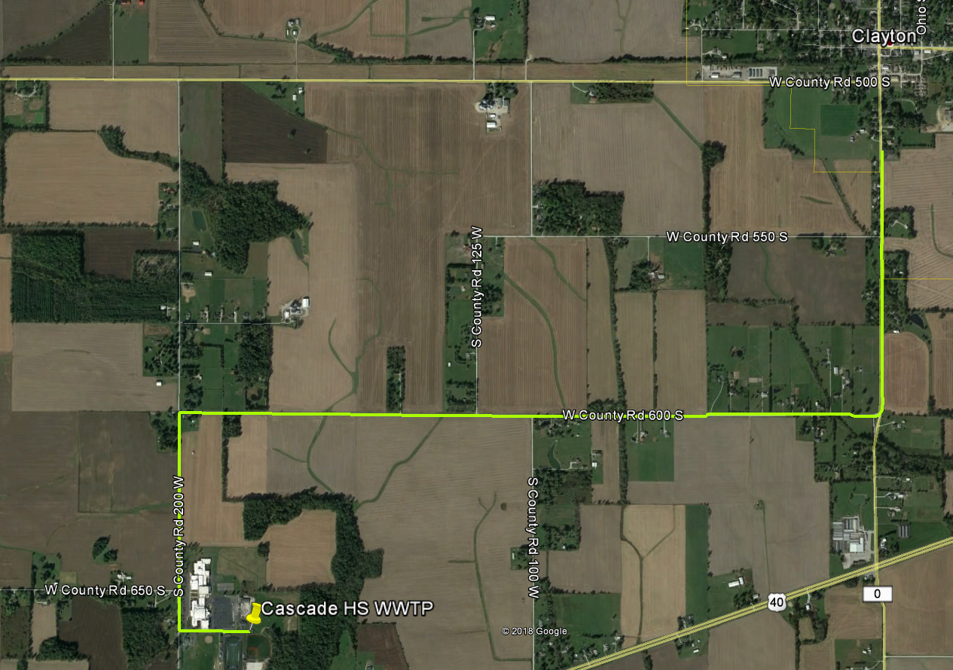
Evaluation of Alternatives Alternative 2 - Regionalization
Alt. 2-1:
Cascade HS
CR200W North
CR600S East
CR0 North to Clayton
MH A17b
~ 18,800 LF or 3.6 miles

Slide 9
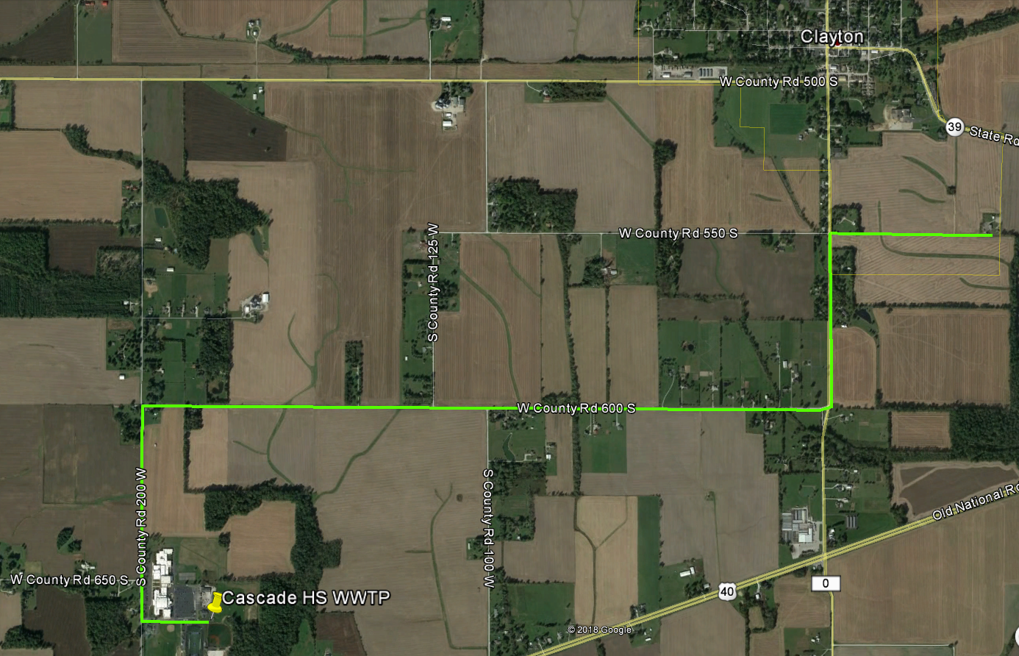
Evaluation of Alternatives Alternative 2 - Regionalization
Alt. 2-1A:
Cascade HS
CR200W North
CR600S East
CR0 North to CR550S
East to WWTP (Easement)
~ 20,000 LF or 3.8 miles

Slide 10
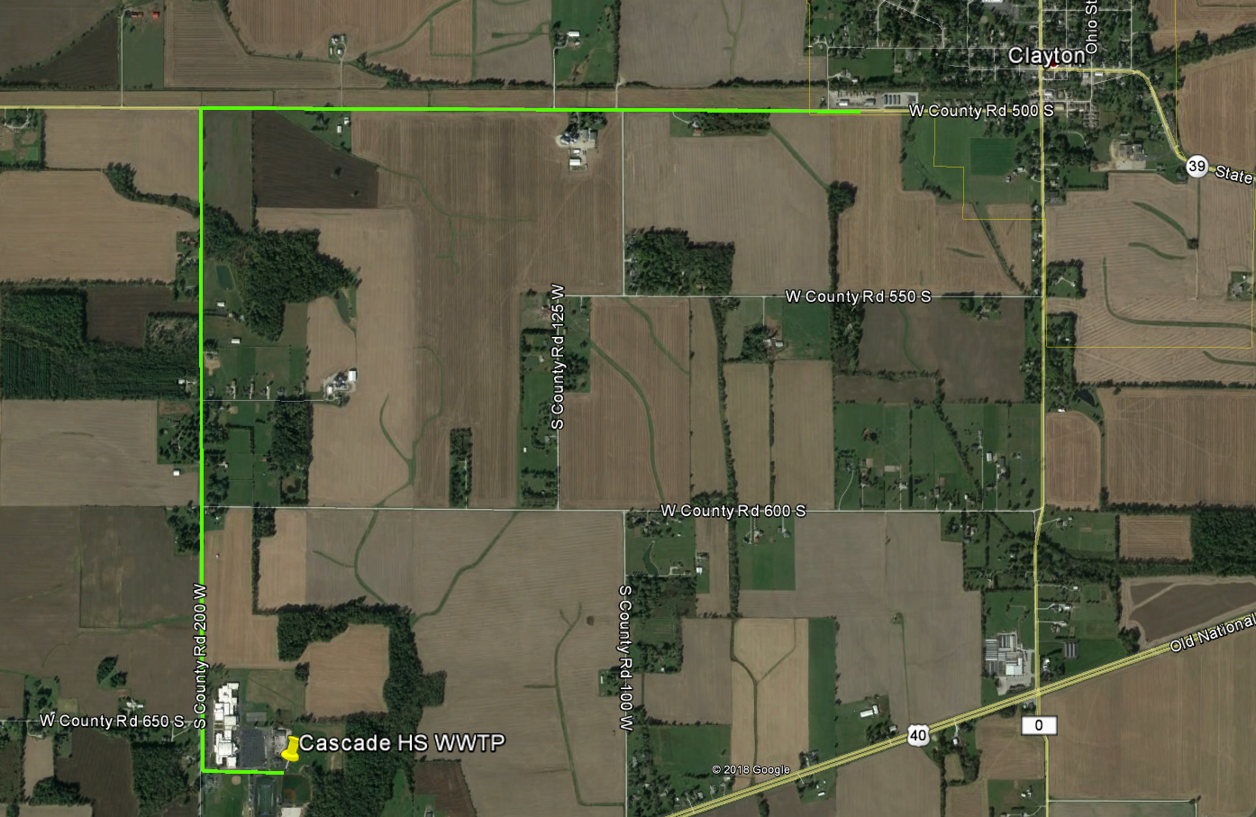
Evaluation of Alternatives Alternative 2 - Regionalization
Alt. 2-2:
Cascade HS
CR200W North
CR500S East to Clayton
MH-A21
~ 17,500 LF or 3.3 miles

Slide 11
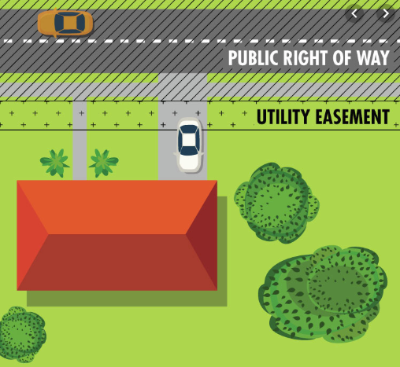
Easements Alternative 2 - Regionalization
Planning Phase Only
No Specific Properties Identified
Minimize Site Disturbance
Protect Existing Features
Temporary vs. Permanent
Road Right-of-Way
Coordination
Negotiations

Slide 12
Costs Project Cost Opinions
Description | Alternative 1 New WWTP | Alternative 2-1 Pumping to CR0 | Alternative 2-1A Pumping to WWTP | Alternative 2-2 Pumping to CR500
Construction Cost ¹ | $1,596,000 | $1,864,000 | $1,932,000 | $1,790,000
Non-Construction Cost ⁴ | $430,000 | $410,000 | $415,000 | $405,000
Land Acquisition ² | --- | $20,000 | $30,000 | $20,000
Connection Fee ³ | --- | $50,000 | $50,000 | $50,000
Project Cost | $2,026,000 | $2,344,000 | $2,427,000 | $2,265,000
¹ Includes 20% contingency.
² Assumes 2 to 3 acres at $10,000 per acre.
³ Assumes 20 EDUs (7,000 gpd/310 gpd/EDU) @ $5,000/EDU. Clayton does not currently charge a connection fee.
⁴ Includes Preliminary Engineering Report (PER) preparation for funding agency approval, if applicable.

Slide 13
Costs Annual OM&R Expenses
Category | Alternative 1 New WWTP | Alternative 2 (Any) Pumping to Clayton
Power ¹ | $20,000 | $4,000
Labor ² | $11,000 | $11,000
Materials/Supplies ³ | $8,000 | $4,000
Administrative ⁴ | $1,000 | $1,000
Maintenance/Repairs ⁵ | $13,000 | $2,000
Outside Services ⁶ | $12,000 | $2,000
Major Equipment Replacement ⁷ | $15,000 | $8,000
Volumetric Charge ⁸ | --- | $31,000
Total, rounded | $80,000 | $63,000
¹ Based on $0.09/kW-hr operating at design capacity.
² Includes (1) part-time contract operator (MCCSC Agreement).
³ Includes fuel, lab, misc. supplies.
⁴ Billing, accounting, insurance, etc.
⁵ Routine maintenance, lubrication, tune-ups, calibrations, etc.
⁶ Includes vactor truck pumping, screenings disposal, sludge disposal, etc. as applicable.
⁷ Includes major equipment cost spread out over its useful life.
⁸ Clayton user charge for schools per Ordinance 2019-2, rounded to nearest 1,000s. ($40 per month for first 10 students/staff + $2.64/month for each additional student/staff).

Slide 14
Costs Present Worth Analysis
Description | Alternative 1 New WWTP | Alternative 2-1 Pumping to CR0 | Alternative 2-1A Pumping to WWTP | Alternative 2-2 Pumping to CR500
Present Worth of Project Cost ¹ | $2,026,000 | $2,344,000 | $2,427,000 | $2,265,000
Present Worth of Annual Cost ² | $1,374,000 | $1,086,000 | $1,086,000 | $1,086,000
Total Present Worth | $3,400,000 | $3,430,000 | $3,513,000 | $3,351,000
¹ Present worth of project cost = project cost.
² Interest rate is 1.5% which is the “real” discount rate per OMB Circular A-94 (for 2019) as recommended by RUS Bulletin 1780-3. Term used is 20 years.

Slide 15
Funding Options
Programs:
State Revolving Fund Loan (SRF)
United States Department of Agriculture’s Rural Development Grant and Loan (USDA RD)
Indiana Office of Community and Rural Affairs (OCRA) Community Development Block Grant (CDBG).
Indiana Bond Bank

Slide 16
Project Schedule
Activity | Milestone Date
Planning Phase | January – June 2020
Design Phase | June – October 2020 (pending easements)
Bidding Phase | November - December 2020
Construction Phase | January – December 2021

Slide 17
Recommendations
Proceed with Alternative 2-1 or 2-2
New Lift Station & Forcemain
Pumping to Clayton
Project Cost = $2.3M ±
Pursue SRF Funding / Prepare PER
Key Benefits
Get out of the Wastewater “Business”
Improve School Campus Site Aesthetics
Regionalization (Favorable for Funding)
Lower Annual Operating Costs
Mutually Beneficial to MCCSC and Town of Clayton

Slide 18
Questions?

